Slide 1

Exploring the Bedding Bathing & Yonder (BBY) Customer Base
Eunice Brandares

Slide 2
Agenda
Introduction
Results
Executive Summary
Recommendation
Methodology
Presentation Title

Slide 3

Introduction
Bedding, Bathing & Yonder (BBY), an American chain of domestic merchandise retail stores, is looking to further strengthen their loyalty program for their customers.

Slide 4


Executive Summary
Objective
To identify the best customer segment for the BBY loyalty program and give insights to the marketing team as to which customers to target to promote brand loyalty and increase revenue.
Key Insights
Best channel is through the internet. This is because people with computers at home spends more on BBY on average than those with magazine subscriptions.
Millennial and Gen-X are perfect target market. At least 79% of the 2018 Millennials and Gen-X US population put importance in home decoration.
The higher a household’s educational attainment is, the more they spend on BBY products.
Customers who live on a Duplex or a Triplex spend more on BBY products on average. However, better to target those on a Residential or Apartment address since they are a larger customer base.

Slide 5





Methodology
Data Exploration
Data Cleaning
Variable Selection
Data Visualization
Recommendation
Sampling
Checking of Data Type, and Null Values
Fixing Data Types, Replacing blank to Null Values, Imputing Missing Values
Excluding variables with more than 30% missing values, and variables that can induce unethical bias (such as race and gender)
Doing frequency counts, histograms, graphical representations of the data
Giving recommendations based on the insights from doing the EDA

Slide 6
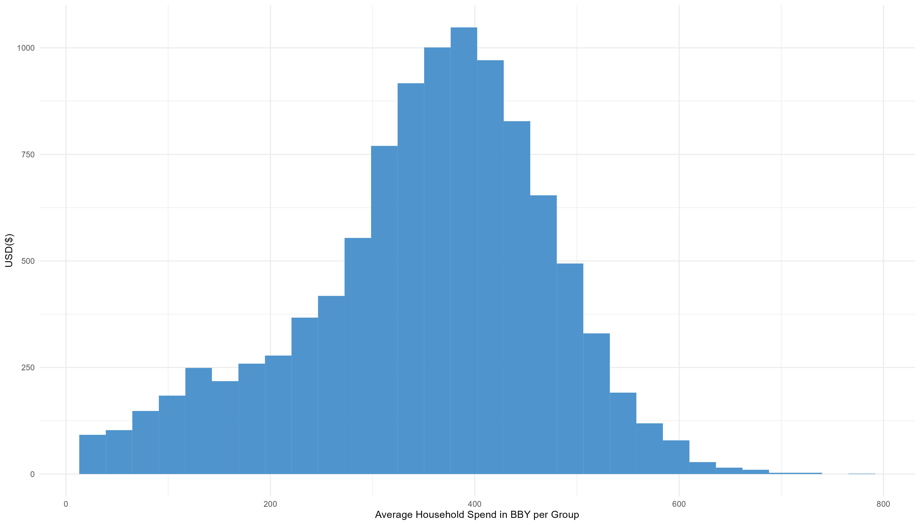
Average Household Expenditure $ with BBY
The average household spending in BBY is around $350-400.

Slide 7
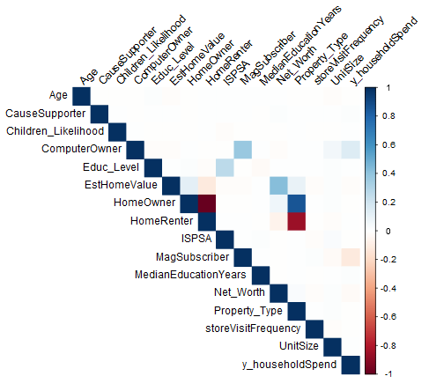
Correlation of the Variables

Slide 8
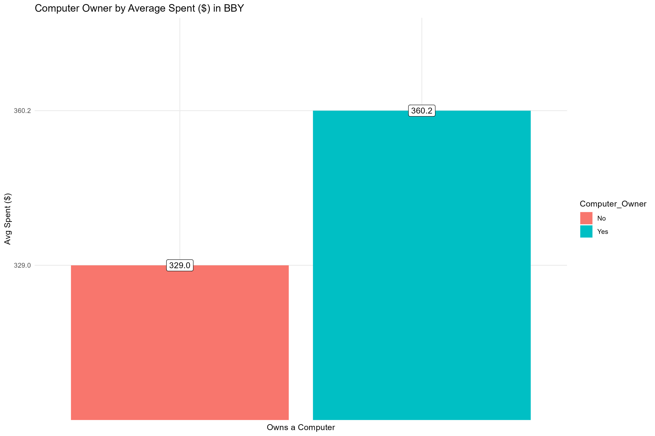
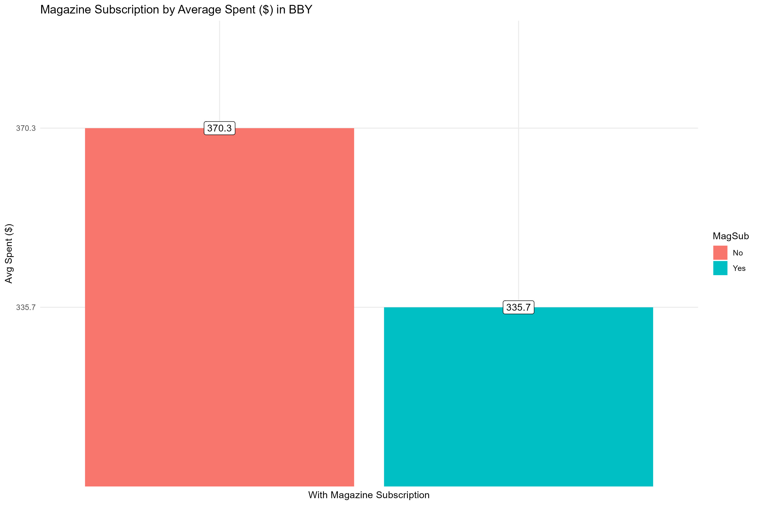
Profile of High Spending Customers

Slide 9
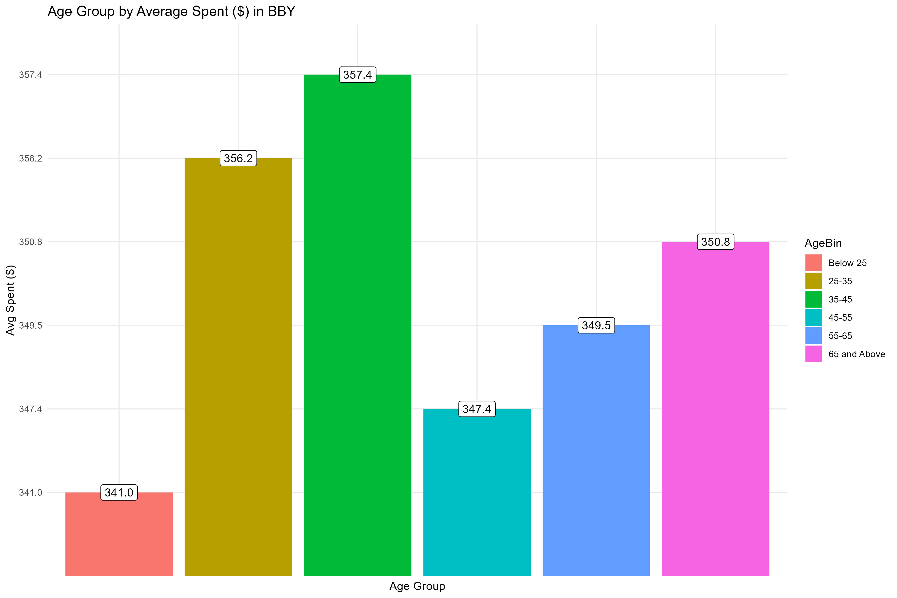
Profile of High Spending Customers

Slide 10
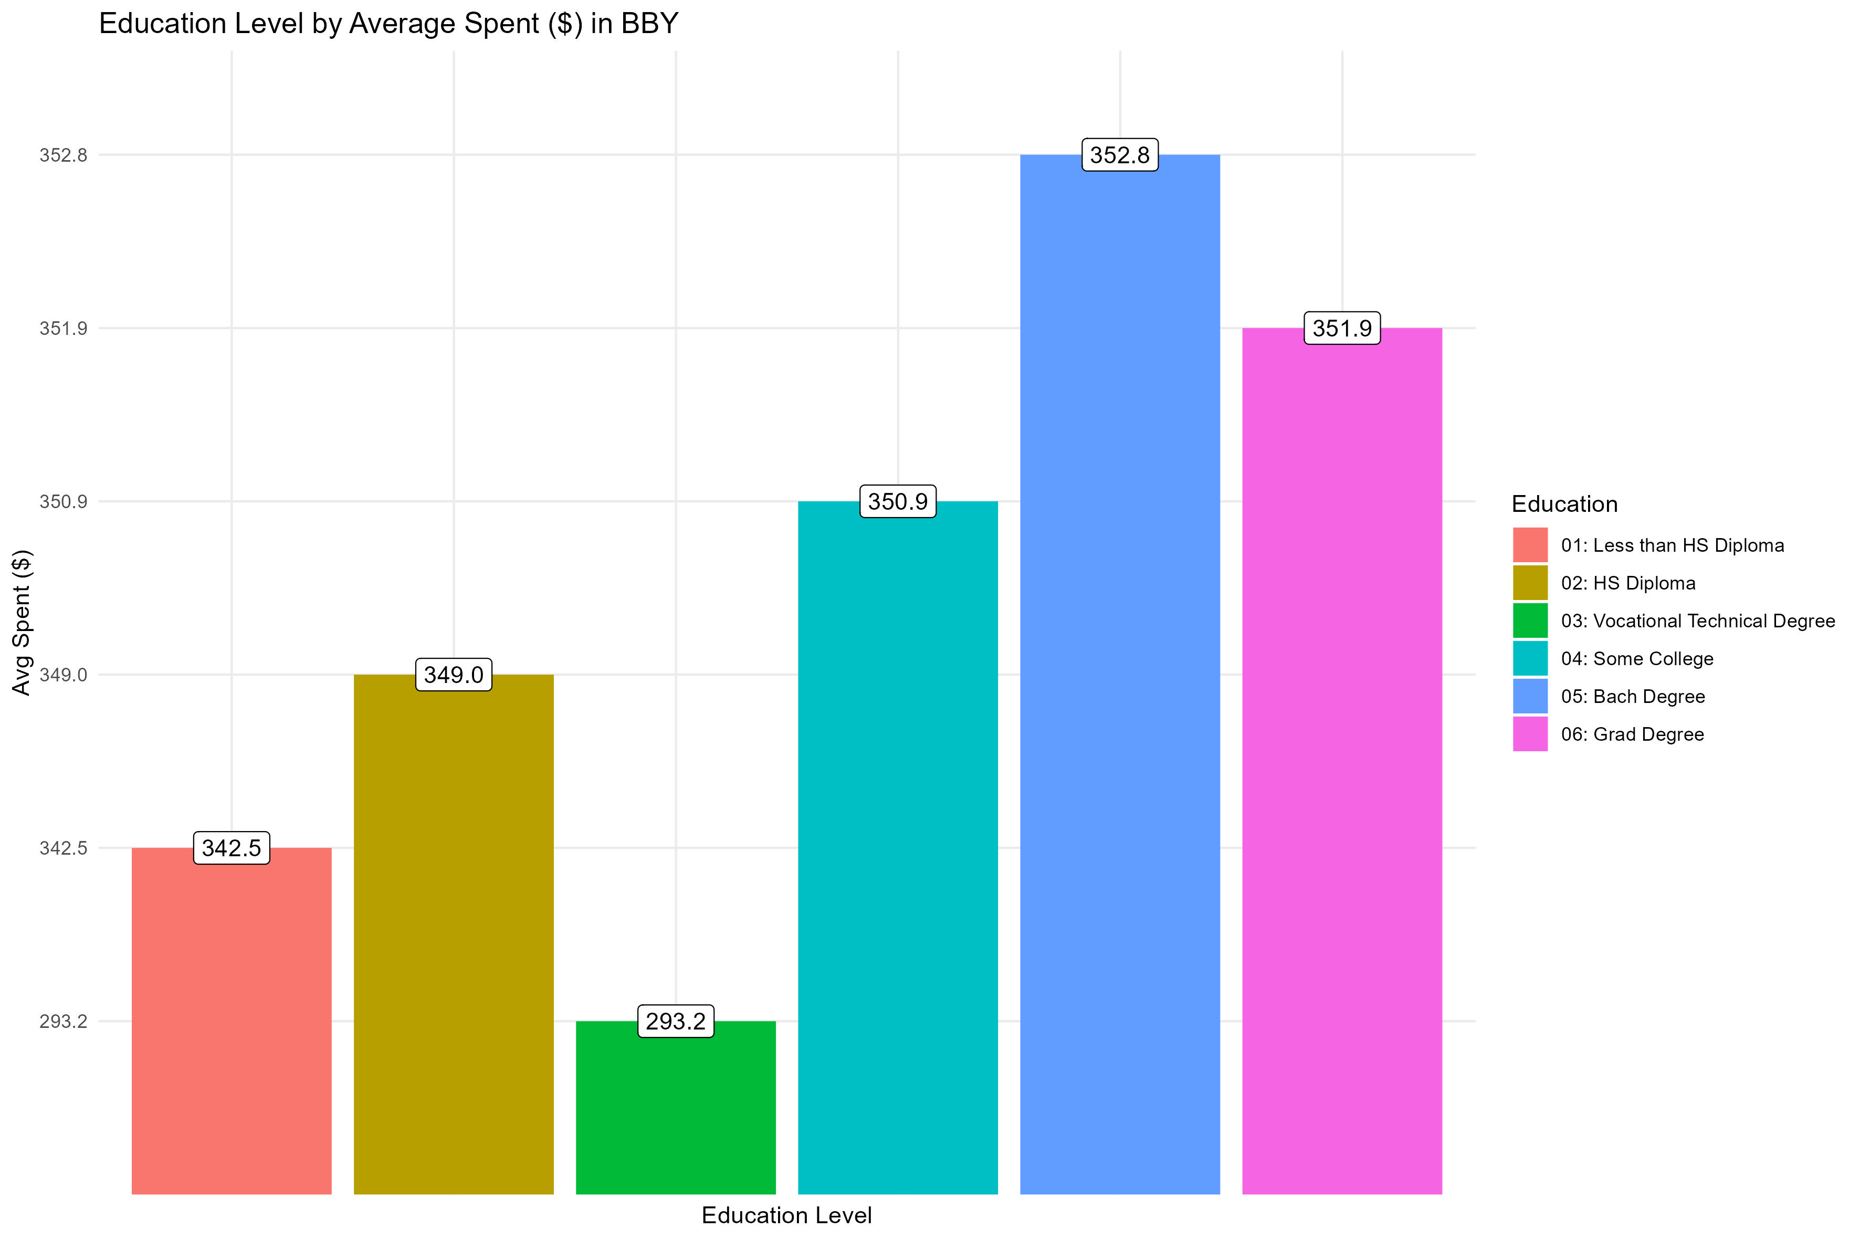
Profile of High Spending Customers

Slide 11
Profile of High Spending Customers

Slide 12
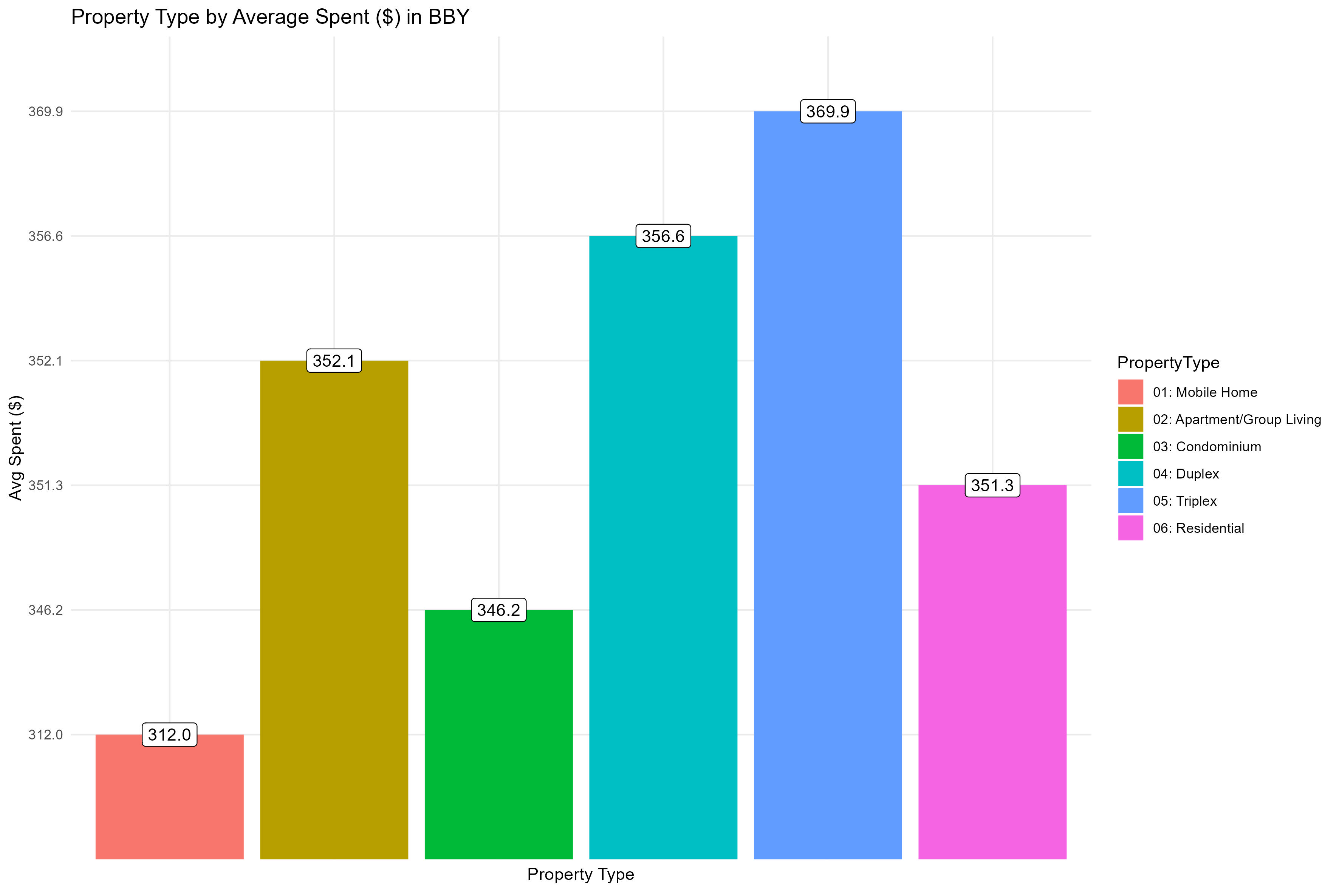
Profile of High Spending Customers

Slide 13
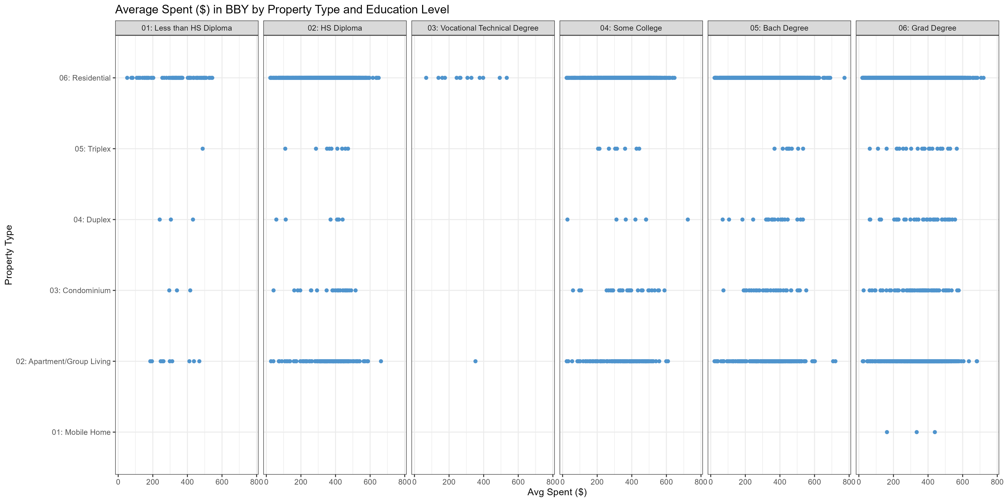
Profile of High Spending Customers

Slide 14


Preferred BBY Customer Profile
Recommending to expand online presence and focus on the preferred Bedding, Bathing & Yonder (BBY) customer demographics shown below:
Key Demographics:
Millennials and Gen-X (aged 25-45)
With higher educational attainment – at least some college
Customers with either a Residential address or an Apartment address.

Slide 15
“Business opportunities are like buses. There’s always another one coming.”
Richard Branson

Slide 16




Thank you
Eunice Brandares
ebrandares@student.hult.edu
https://www.linkedin.com/in/eunice-brandares/

